Slide 1
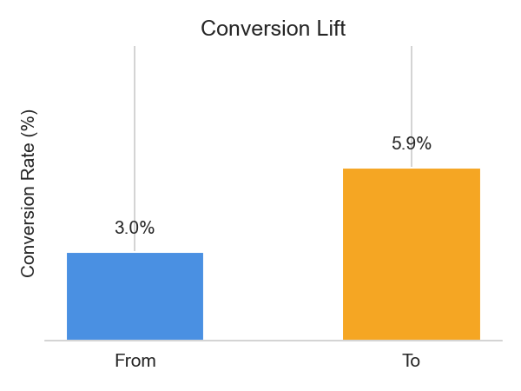
Our Context and the Key Question
We operate a retail chatbot on WhatsApp, currently sending text-only sales messages weekly with a single button for automated purchase. This current approach has a conversion rate of about 3.00%. We believe there is an opportunity to significantly improve our automated sales conversion without incurring high costs for custom image creation for every message. We want to determine if modifications like including an image or adding an extra button for customer service can lead to significant improvements in conversion rates, specifically aiming for a variant that is 85% or more likely to be the best and carries less than 1% risk.

Slide 2
Our Recommendation to Answer the Question
Yes, Variant D, which incorporates both an image and an additional button to speak with an attendant, is the most effective solution, significantly improving conversion rates while meeting our success metrics.
🏆

Slide 3
Variants Tested
Variant A (Control): This variant is the message we already send. It has only text and a button that leads directly to the automated purchase point of the chatbot.
Variant B (Image Focus): This variant contains the same text and button as Variant A, but also has an image. With it, we want to know if having an image impacts conversion.
Variant C (Extra Button, No Image): This message is almost identical to Variant A. Same text, no image, but with two buttons instead of one. The first button continues to be the one that leads to the automated purchase flow; the new button directs the user to speak with an attendant.
Variant D (Extra Button, With Image): This message is identical to Variant C, with the addition of an image (the same image as Variant B).

Slide 4
Key Evidence: Why This Recommendation Works
Variant D achieved a Probability to be Best of 1, meaning it was 100% likely to be the best performer, surpassing our 85% success threshold.
It demonstrated the highest posterior mean conversion rate at 0.0587441 (approximately 5.87%).
Variant D successfully converted 587 out of 10000 reach, significantly outperforming the control Variant A which converted 300 out of 10000 reach.

Slide 5
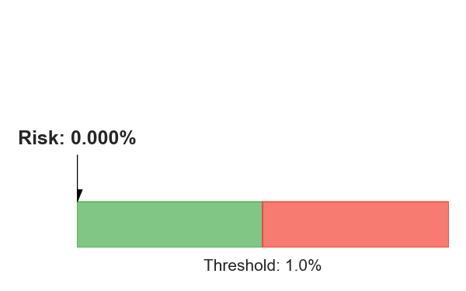
Risk Assessment of the Recommendation
Variant D exhibited an Expected Loss (Risk) of 0, which is well below our defined threshold of less than 1% (0.01). This indicates that implementing Variant D carries no practical risk based on the test results and is a safe choice for adoption.

Slide 6
Expected Business Impact
Adopting Variant D is projected to significantly boost our automated sales conversion rates. The current conversion rate for Variant A (control) is 0.030047. With Variant D achieving a posterior mean conversion rate of 0.0587441, this represents a conversion lift of 0.0286971, nearly doubling our current performance. This substantial increase directly translates to more automated purchases and improved efficiency in our WhatsApp sales channel.

Slide 7
Immediate Action Plan
Implement Variant D as the new standard message for all future weekly sales campaigns on the WhatsApp retail chatbot.
Continuously monitor the performance of Variant D to ensure sustained positive conversion trends and identify any future optimization opportunities.
Analyze user interactions with the new 'speak with attendant' button to understand its contribution to overall customer experience and potential sales funnel impact.

